Slide 1

COVID 19 ANALYSIS
By Sarthak Dwivedi

Slide 2
OUTLINE
COVID-19 India Overview
Percentage Distribution of Confirmed Cases
Monthly Confirmed/Cured/Deaths
Total Percentage of Deaths vs Cured vs Confirmed
Statewise Number of Confirmed Cases
Statistic of Chosen State
Comparison of Deaths vs Cured vs Confirmed
Dashboard Overview

Slide 3

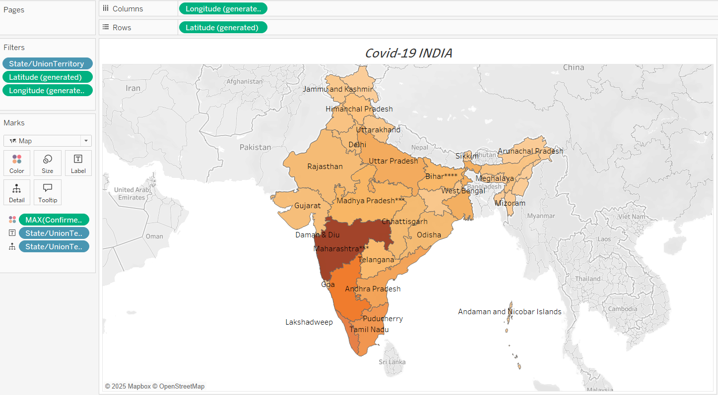
COVID – 19 India
This is a filled map chart representing COVID-19 cases across Indian states:
Rows/Columns: Latitude (generated) and Longitude (generated) are used to position data points geographically.
Filters: State/Union Territory filters specific regions, while Latitude and Longitude refine the map’s focus.
Marks:
Chart Type: Map.
Colour: MAX(Confirmed Cases) determines intensity (darker shades = higher cases).
Details/Labels: State/Union Territory adds state-wise names for better clarity.
The chart visually highlights state-level variations in COVID-19 cases, making it easy to identify hotspots.

Slide 4

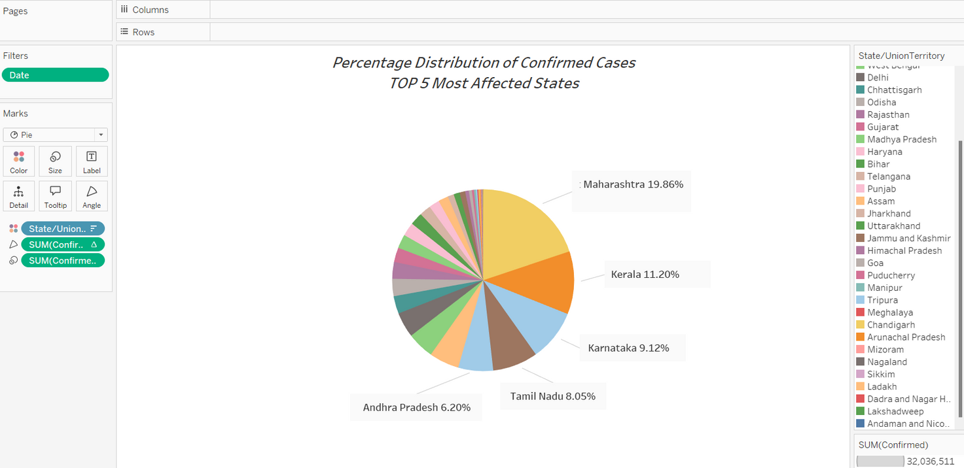
Percentage distribution of confirmed cases
Chart Type: Pie chart for displaying percentage contributions of states to total confirmed cases.
Rows/Columns: None added; the pie chart does not require these.
Filters:
Date: Filters data for a specific timeframe, ensuring relevance to the selected period.
Marks:
Color: Each state/union territory is assigned a unique color for easy differentiation.
Angle: SUM(Confirmed Cases) determines the proportional slice size in the pie.
Labels: State/UT names and their percentage contributions are displayed for clarity.
Insights:
The chart highlights Maharashtra as the most affected state (19.86%), followed by Kerala (11.20%) and Karnataka (9.12%). It visually emphasizes the distribution of cases among the top contributors.

Slide 5

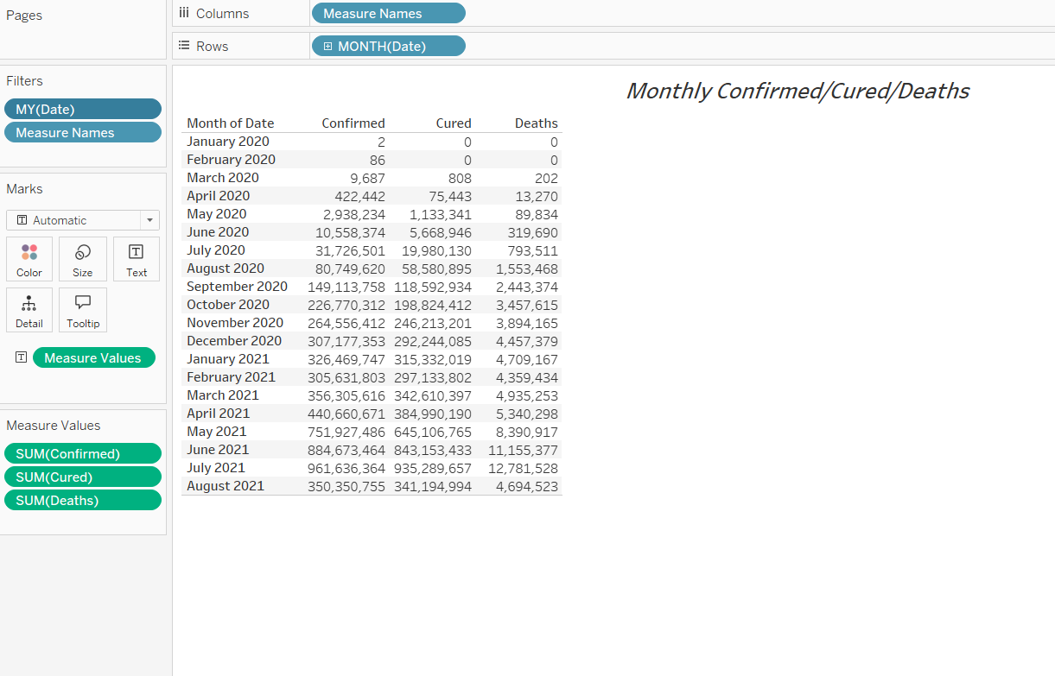
Monthly Cured/Death/Confirmed Cases
Rows: MONTH(Date) organizes data month-wise for clear chronological trends.
Columns: Measure Names displays categories (Confirmed, Cured, Deaths).
Filters:
MY(Date): Filters the timeline to focus on relevant months.
Measure Names: Ensures only the selected measures (Confirmed, Cured, Deaths) are displayed.
Marks:
Type: Automatic, for tabular representation.
Measure Values: Includes SUM(Confirmed), SUM(Cured), and SUM(Deaths) to populate the table.
Insights:
The table provides a detailed breakdown of confirmed cases, recoveries, and deaths over time. It helps track trends, such as spikes in cases or improvements in recovery rates across specific months.

Slide 6

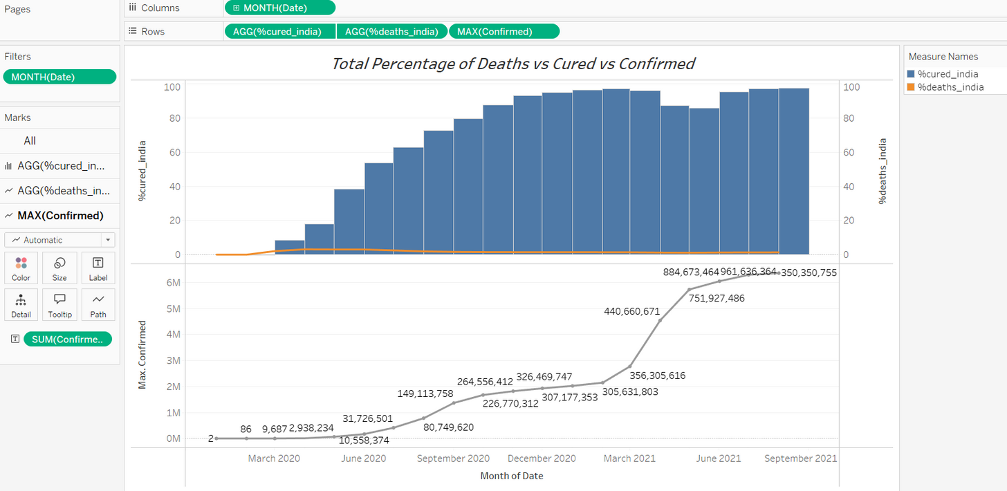
Total % of death vs cured vs confirmed
This chart provides a monthly comparison of % Cured, % Deaths, and Confirmed Cases:
Bars: Represent the recovery percentage (%cured_india), showing steady improvement over time.
Lines: Display death percentage (%deaths_india) and total confirmed cases (MAX(Confirmed)) on a secondary axis to track trends.
Rows/Columns: Data is organized by MONTH(Date) with aggregated values for recoveries, deaths, and confirmed cases.
Filters: The timeline is filtered by MONTH(Date) for focused analysis.
Insights:
Recovery rates show consistent growth, indicating effective healthcare responses.
Death percentages remain low, reflecting controlled fatality rates.
Confirmed cases rise sharply during certain periods, highlighting peak phases of the pandemic.
This visualization effectively captures the relationship between recoveries, deaths, and confirmed cases over time.

Slide 7
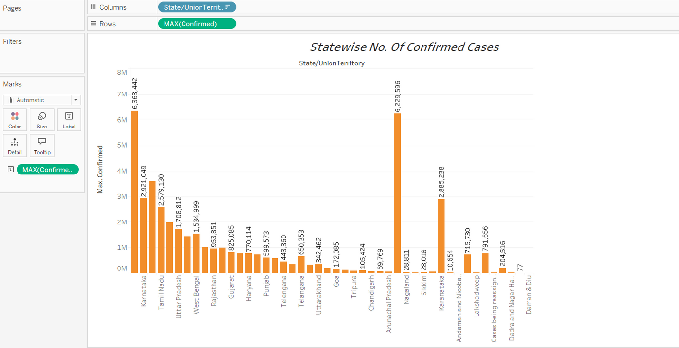
State-wise no. of confirmed cases
Chart Type: Pie chart for displaying percentage contributions of states to total confirmed cases.
Rows/Columns: None added; the pie chart does not require these.
Filters:
Date: Filters data for a specific timeframe, ensuring relevance to the selected period.
Marks:
Color: Each state/union territory is assigned a unique color for easy differentiation.
Angle: SUM(Confirmed Cases) determines the proportional slice size in the pie.
Labels: State/UT names and their percentage contributions are displayed for clarity.
Insights:
The chart highlights Maharashtra as the most affected state (19.86%), followed by Kerala (11.20%) and Karnataka (9.12%). It visually emphasizes the distribution of cases among the top contributors.

Slide 8
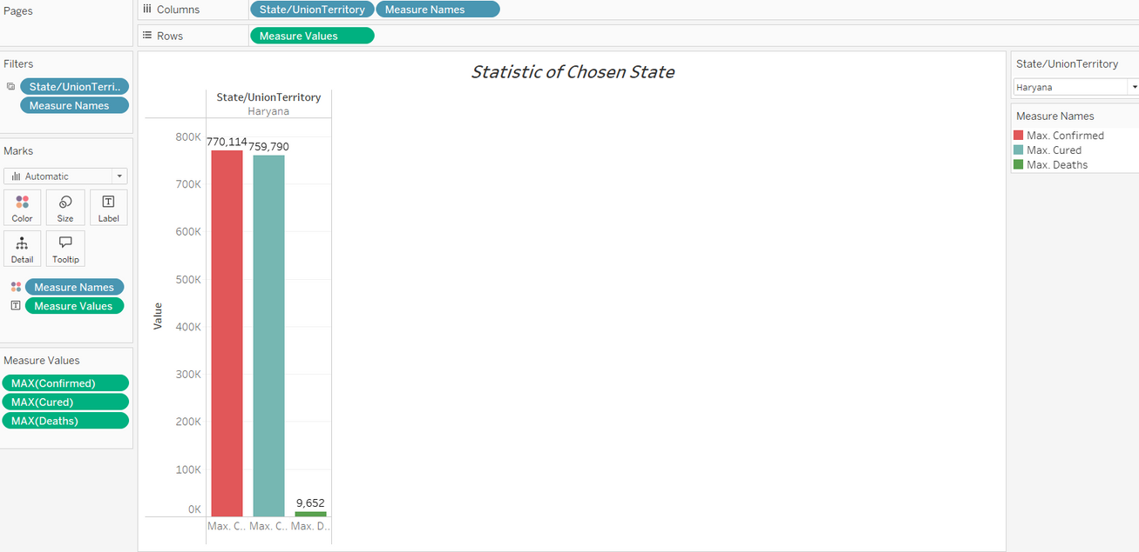
Statistic of the chosen state
This chart represents the Statistics of a Chosen State, allowing users to filter and view data for a specific state, such as Haryana in this example.
Features:
Filter: State/UnionTerritory allows selection of a specific state to analyze.
Columns: State/UnionTerritory displays the selected state's name.
Rows: Measure Values includes aggregated measures for confirmed, cured, and deaths.
Marks:
Bars: Show MAX(Confirmed), MAX(Cured), and MAX(Deaths) for the selected state.
Color: Differentiates between confirmed, cured, and death metrics for clarity.
Insights:
In Haryana:
Confirmed Cases: 770,114.
Cured Cases: 759,790, indicating a high recovery rate.
Deaths: 9,652, reflecting a relatively low fatality rate.
The filter functionality provides a dynamic way to explore detailed statistics for any selected state.

Slide 9

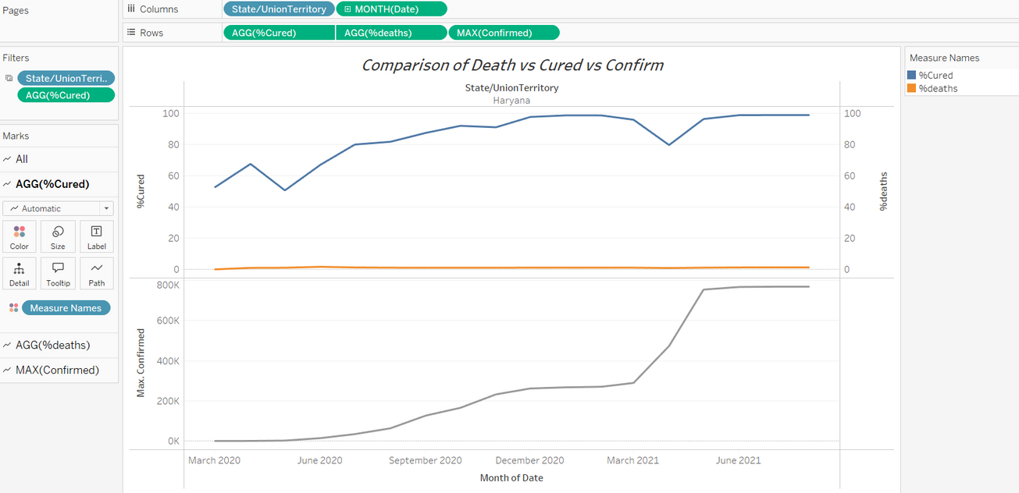
Comparison of death vs cured vs confirmed
This chart visualizes the Comparison of Deaths vs Cured vs Confirmed Cases for a selected state, here Haryana, over time:
Features:
Filter: State/UnionTerritory allows selecting a state for analysis.
Columns: State/UnionTerritory and MONTH(Date) organize data monthly for the chosen state.
Rows:
AGG(%Cured): Aggregates the percentage of recovered cases.
AGG(%Deaths): Aggregates the percentage of deaths.
MAX(Confirmed): Shows the maximum confirmed cases.
Marks:
Lines: Display trends for %Cured and %Deaths.
Path: Tracks the progression of confirmed cases over time.
Insights:
The recovery percentage steadily increases over time, reaching nearly 100%.
Deaths maintain a consistently low percentage, indicating effective fatality management.
Confirmed cases show exponential growth during peak months but taper off as recoveries rise.
This chart effectively illustrates recovery trends, controlled fatalities, and case growth, highlighting the state's pandemic response.

Slide 10
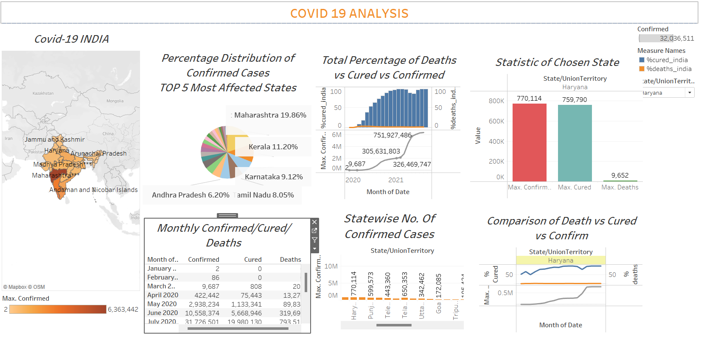
Dashboard Creation

Slide 11

COVID-19 Analysis Dashboard summarises key insights using multiple visualisations:
COVID-19 India Map:
Shows confirmed cases across states, with darker shades indicating higher cases.
Percentage Distribution of Confirmed Cases:
Pie chart highlights top 5 affected states by case percentage (e.g., Maharashtra: 19.86%).
Total Percentage of Deaths vs Cured vs Confirmed:
Combination chart shows the progression of recoveries, deaths, and confirmed cases over time.
Statistic of Chosen State:
Bar chart displays confirmed, cured, and death counts for a selected state (e.g., Haryana).
Monthly Confirmed/Cured/Deaths:
Tabular view tracks monthly trends for confirmed cases, recoveries, and fatalities.
Statewise No. of Confirmed Cases:
Vertical bar chart compares confirmed cases across all states.
Comparison of Death vs Cured vs Confirmed:
Line and area chart compares recovery and death percentages with confirmed case trends.
This dashboard provides a comprehensive overview of the pandemic, making it easy to analyze trends, state-wise impacts, and recovery rates.

Slide 12
THANK YOU!

